Slide 1
Multi-agent simulation
Home Depot Center

Slide 2
Multi-Agent Simulation
System composed of multiple interacting intelligent agents
  Each agent represents an “individual” person
    Civilians
    Police
    Fire/Medical Personnel
    Insurgents
  Typically involve a certain terrain or specific facility/location
    Extensive background knowledge of area must be known prior
    Scenarios must be able to fit all other situations (locations change, concepts do not)

Slide 3
Multi-Agent Simulation
Systems are used to simulate events that are otherwise impossible or impractical to simulate in real life
Utilizes Agent-Based Modeling
  Kept as basic as possible in an effort to generalize certain events
    In some situations, high-resolution events require a larger amount of computation, making them impractical

Slide 4
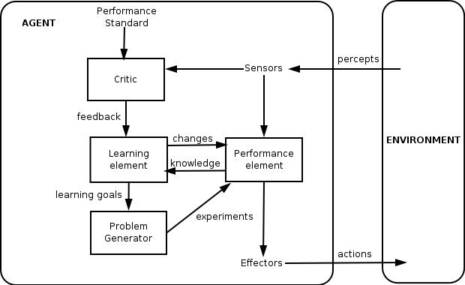

Slide 5
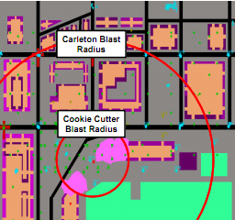
Pythagoras
Agent-Based Model
  Incorporates soft rules to distinguish unique agents
  Includes the concept of affiliation
  Uses desires to motivate agents into moving and shooting
    Desires are capable of changing through multiple factors (charismatic, hierarchical, etc.)
  Allows for behavior-changing events and actions
  Retains traditional weapons, sensors, and terrain
Open-Source Software
Refinement of the U.S. Marine Corps Warfighting Laboratory’s Project Albert

Slide 6
SACNAS 2011
An abstract will be submitted utilizing the Pythagoras ABM to simulate a vignette
A crisis event will be simulated at the Home Depot Center
Simulation will begin at the start of a specific event
  Will not be event-driven

